Slide 1
Introduction to Machine Learning

Slide 2
Traditional vs ML

Slide 3
Machine Learning Types
Machine Learning
Supervised
Unsupervised
Reinforcement
Classification
Regression
Clustering

Slide 4
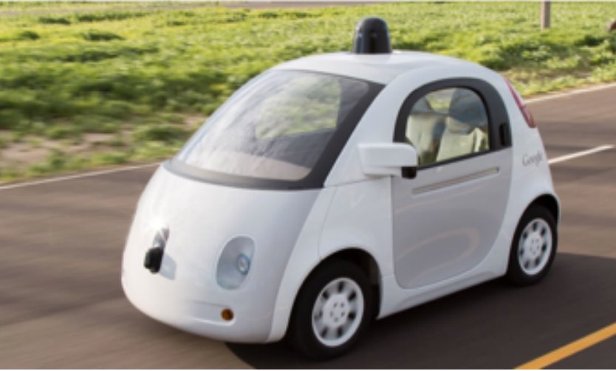
Use cases

Slide 5
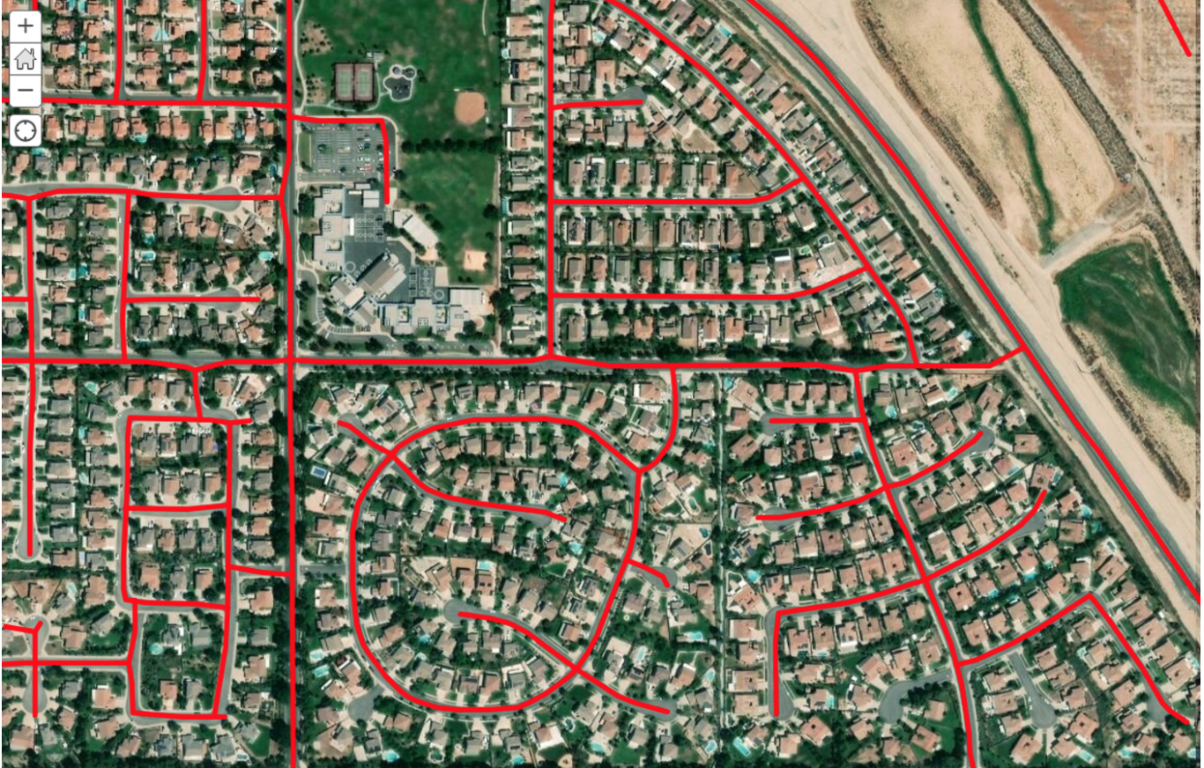
Geographic Information Systems (GIS)
A computer system for capturing, storing, checking, and displaying data related to positions on Earth's surface
https://medium.com/geoai/integrating-deep-learning-with-gis-70e7c5aa9dfe

Slide 6
Thank you!!

